Slide 1
Specialised Animal Cells II

Slide 2
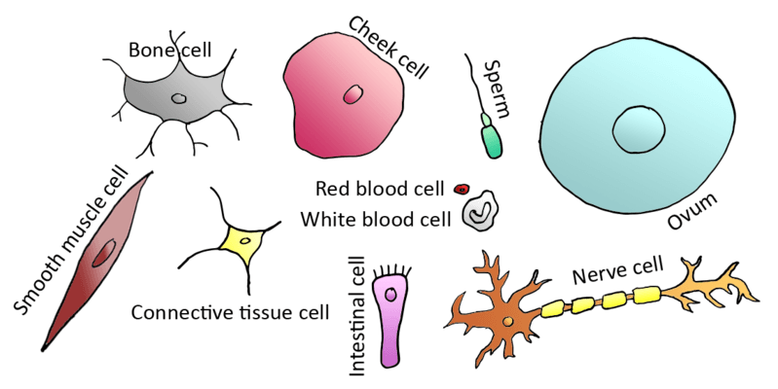
In this Smart Lesson, you will be doing the following:
1. | Recalling why multicellular organisms require specialised cells.
2. | Describing the structure of blood cells and fat cells and relating the structure of each type of cell to its function.

Slide 3
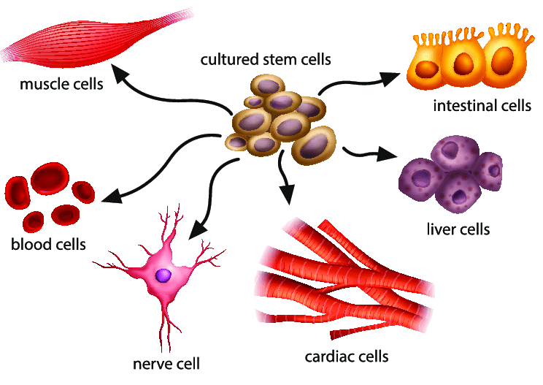
You have over 200 different types of cells in your body!
Each of these different cell types has a specific function. The cells all work together but they don't all do the same thing.
This means that if the function of one type of cell is disrupted it can affect the functioning of the whole body.

Slide 4
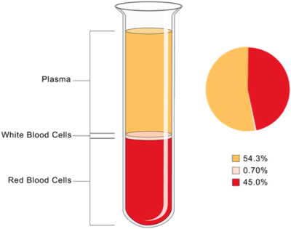
Blood is essentially made up of cells suspended in a liquid.
The liquid is called plasma and makes up about half of the content of blood. In the picture below, the yellow layer is plasma.

Slide 5
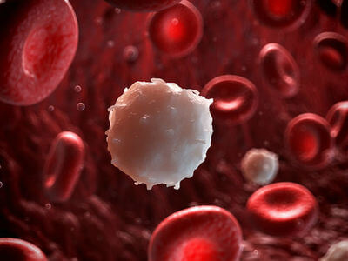
The two main types of blood cells suspended in the plasma are the red blood cells and white blood cells.
These cells have different functions, and the structure of each is ideally suited to their function.

Slide 6
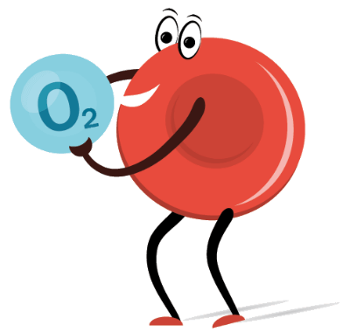
Red blood cells carry oxygen from your lungs around your body to other cells.
The oxygen is then used in cellular respiration to produce the energy your cells need. This is an extremely important job, because if your brain is deprived of oxygen for even five minutes, it can be severely damaged!
Red blood cells also carry the carbon dioxide produced in cellular respiration back to your lungs so that you can remove from your body by breathing out.

Slide 7
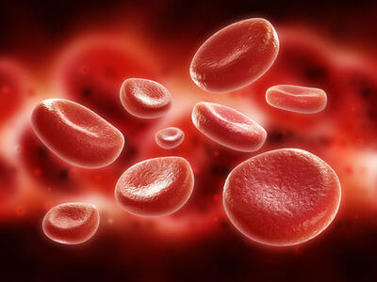
Red blood cells are very small, which allows them to move through tiny blood vessels.
They also lose their nucleus soon after they are made, which allows them to acquire a donut-shape with a larger surface area. This allows them to carry more oxygen molecules.

Slide 8
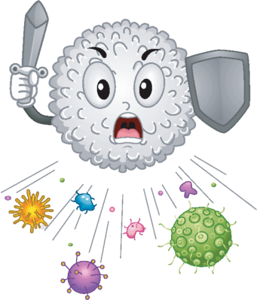
Unlike red blood cells, the white blood cells are part of the immune system.
They help your body to fight infection by destroying pathogens (harmful bacteria and viruses).
White blood cells are slightly larger than red blood cells and contain special molecules called antibodies that help them to kill bacteria and viruses.

Slide 9
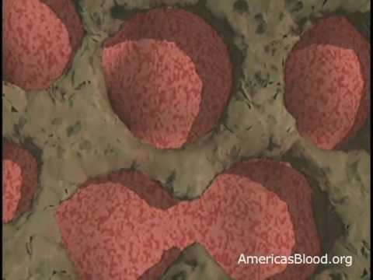

Slide 10

Every person has many fat cells in their body. Fat cells are used to store energy in the form of fat. They are mostly found just underneath your skin around your waist, bottom and chest.

Slide 11
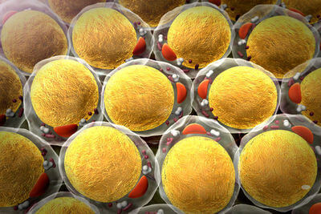
You actually have two different types of fat cells: brown fat cells and white fat cells.
These cells have different functions, and the structure of each is ideally suited to their function.

Slide 12
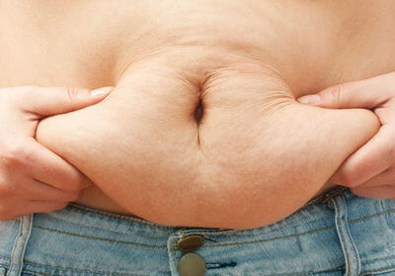
White fat cells are the ones you would typically think of as "fat".
These cells store fat and release it as fatty acids into the bloodstream when blood glucose levels are low. These fatty acids are then broken down into glucose, which is used by all cells for energy to carry out cellular respiration.
White fat cells also act as insulation to help keep your body at a constant temperature.

Slide 13
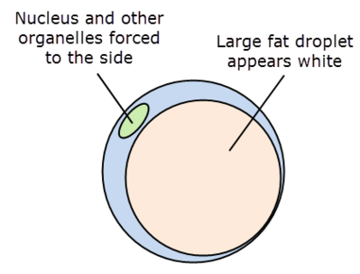
White fat cells store fat, so they are large and round with a large fat droplet in the middle of the cell. The round shape makes them good for storage.

Slide 14

Brown fat cells are fat cells that burn fat to produce heat. They are activated when you get cold, and may be an important factor in weight control.
Babies have a lot of brown fat cells because they can't shiver to keep themselves warm.

Slide 15
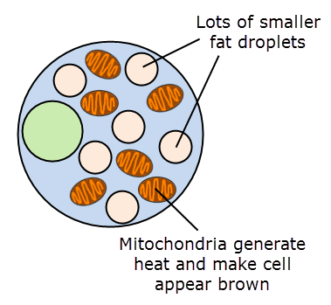
Brown fat cells have lots of mitochondria to help them burn fat and produce heat. Heat energy is produced when mitochondria carry out cellular respiration, and helps to warm up your body when it is cold.

Slide 16


